Slide 1
‘In Other Words’
Select ten “Quotable Quotes” which express your philosophy of life. Choose quotations that represent your thoughts on several aspects of life –not only love, but also faith, success, integrity. character, friendship, etc. List the TEN you have selected, including ATTRIBUTION (who said it). Then for each, briefly describe its personal meaning to you, how it relates to your life, & how it inspires you.
Each “Quotable Quote” will be worth 10 points each. Points will be deducted if you do not include the attribution or the brief personal meaning.
You have the ability to chose the product that you will create, whether that be some kind of poster, book, or PowerPoint presentation. This should look nice and not like something put together in a short amount of time.
The deadline for this project is:
A Day - 4/24/18
B Day – 4/25/18
C Day – 4/26/18

Slide 2
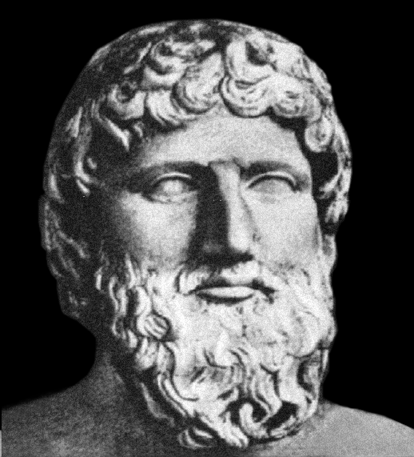
Quotation #1
“It is the mark of an educated mind to be able to entertain a thought without accepting it.”
~ Aristotle
I feel that everyone should keep an open mind about the world around them. You don’t have to accept an idea, but you should accept other people’s acceptance without ridicule.

Slide 3
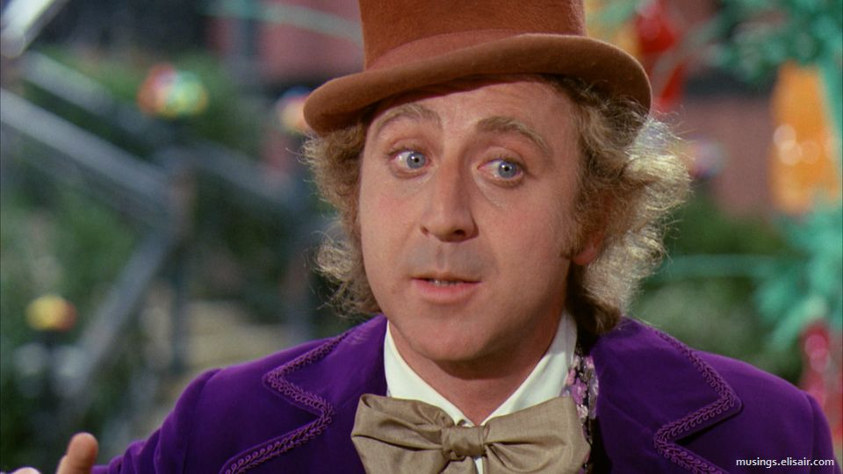
Quotation #2
“We are the music makers, and we are the dreamers of dreams.”
~ Willy Wonka
I feel everything that we read, hear, etc comes from the very minds of the people. We all have the power to bring something to life and that’s what makes the world a beautiful place.

